Slide 1


DEPARTMENT OF INFORMATION TECHNOLOGY
V R SIDDHARTHA ENGINEERING COLLEGE
Avantel Project
Health Care Management System
Domain : Health Care
B.Tech in INFORMATION TECHNOLOGY
MINI Project Review Presentation
Presented by :
N.Manasa Devi( 208W1A1238 )
P.Bhavya Sri( 208W1A1240 )
Under the guidance of
Dr S Suhasini, Asst Prof

Slide 2
AGENDA
Problem statement
Objectives and outcomes
Literature review
Requirements of project
Architecture diagram
Sequence diagram and implementation steps
Use Case diagrams and implementation steps

Slide 3
PROBLEM STATEMENT
To create a web application and mobile application to offer health care services for patients, doctors, pharmacists and lab operators.

Slide 4
OBJECTIVES
Phase-1: Developing the website for the health care management system.
Phase-2: Developing mobile application for the health care management system.
Phase-3:
Apply authentication & security in web application and mobile application. Identify and handle OWASP API security top 10 vulnerabilities 2019 in apis exposed by the web application.
Implement tls v1.2 in apis for securing data transfer between web server and mobile/web application. Implementation of logging and registration for all users in the proposed system. Design registrations, schedules, calendars, e-prescription through dashboard.

Slide 5
OUTCOMES
Web application and mobile app for both operating systems (ios & android ) where users can consult a doctor via text (or) voice (or) video by scheduling an appointment before hand.
Patients are able to easily book lab tests and medicines prescribed by doctor.
It has e-prescription of doctor which will be easy for pharmacists.

Slide 6
Literature Review:

Slide 7
REQUIREMENTS OF PROJECT
Front End
Software Requirements
React
VS Code
Android Studio
Windows & Kali OS
Back End
Next Js
MongoDB database
Mobile App
Kotlin ( or ) React Native

Slide 8
Architecture Diagram:

Slide 9
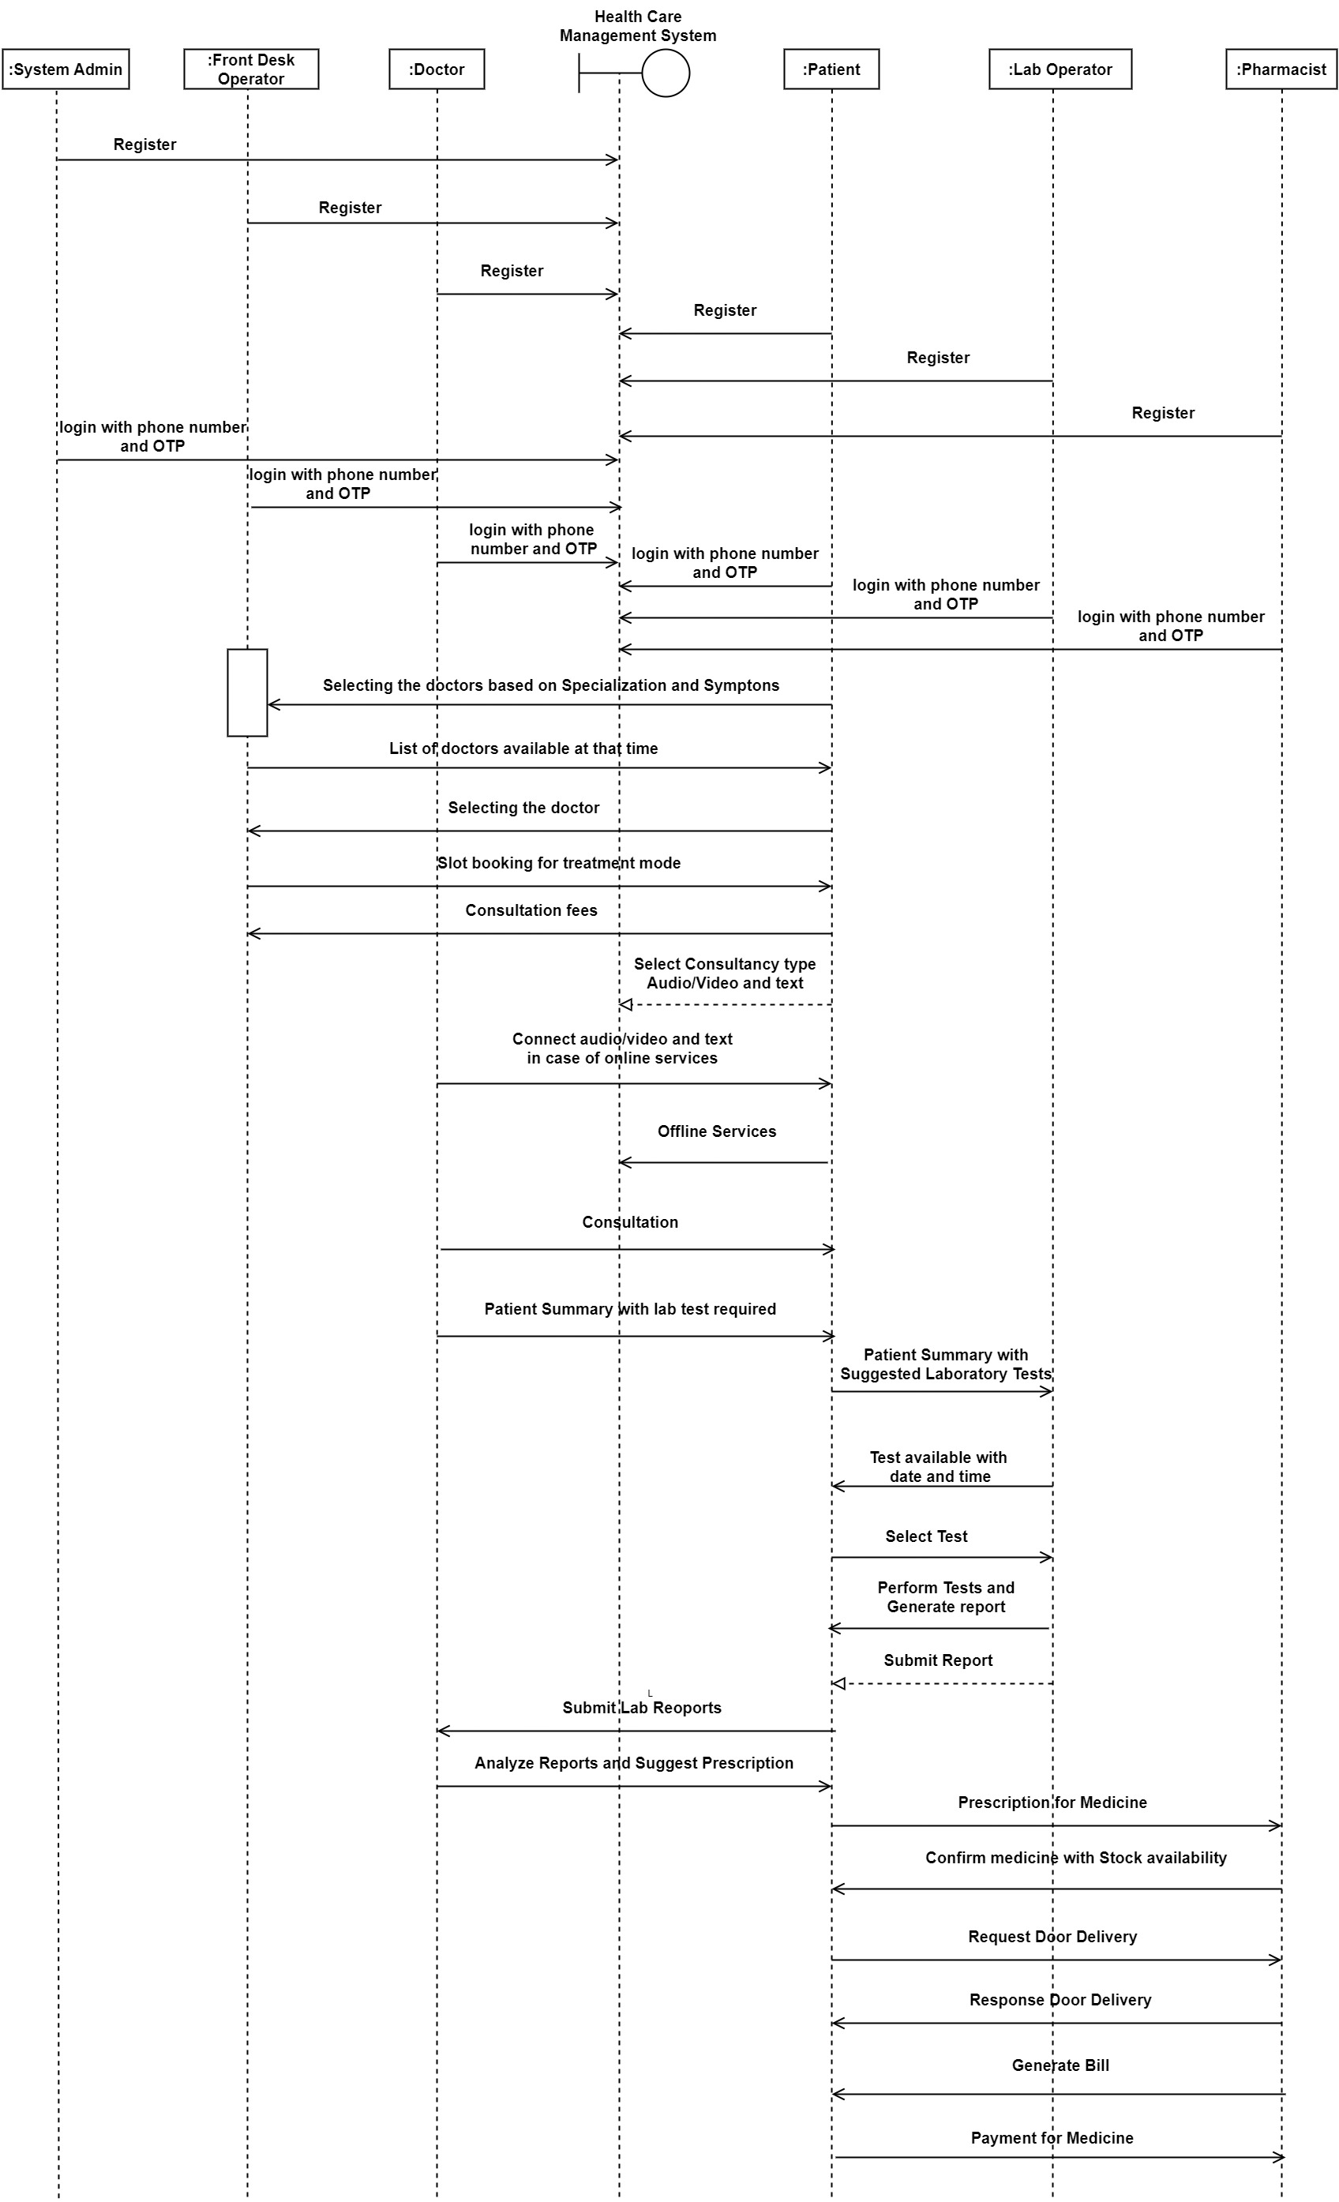

Slide 10
Implementation Steps for Sequence Diagram:
The actor (Patient, Doctor, Lab Operator, Pharmacist, Admin, Front Desk Operator) logs in with their phone number and OTP authentication.
Once logged in, the actor registers with their respective fields of details.
After registration, the Patient is presented with a list of Doctors from which they can choose for treatment.
The Patient provides details of their symptoms to the chosen Doctor.
If online service is chosen, the Doctor and Patient communicate through a video or audio call for the treatment.
The Doctor suggests lab tests if needed, and the Patient completes the tests and submits the report to the Doctor.
After reviewing the report, the Doctor prescribes medication to the Patient.
The Patient can choose to buy the prescribed medication or opt for door delivery.
If the Patient decides to buy the medicine, they make the transaction with the respective Pharmacist.
The Pharmacist provides the medication to the Patient.
If the Patient chooses door delivery, the Pharmacist delivers the medication to the Patient.

Slide 11
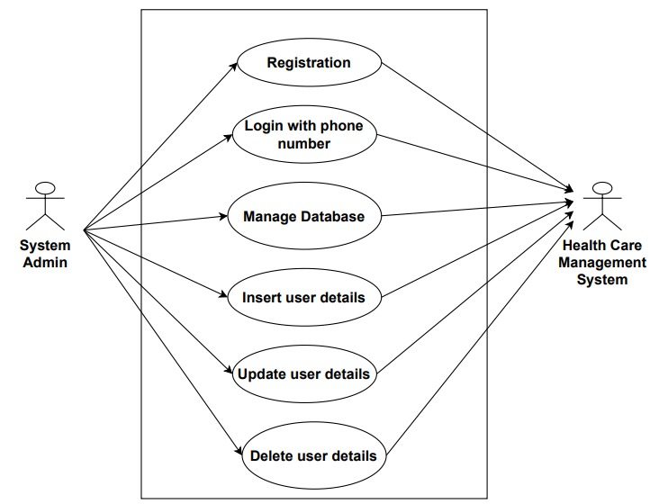
Use Case Diagram For System Admin:
Use Case Diagram For System Admin:

Slide 12
Description:

Slide 13
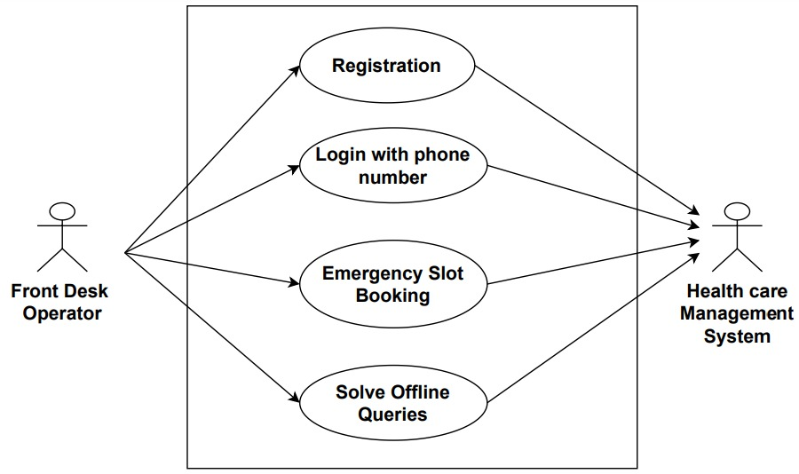
Use Case Diagram For Front Desk Operator:

Slide 14
Description:

Slide 15
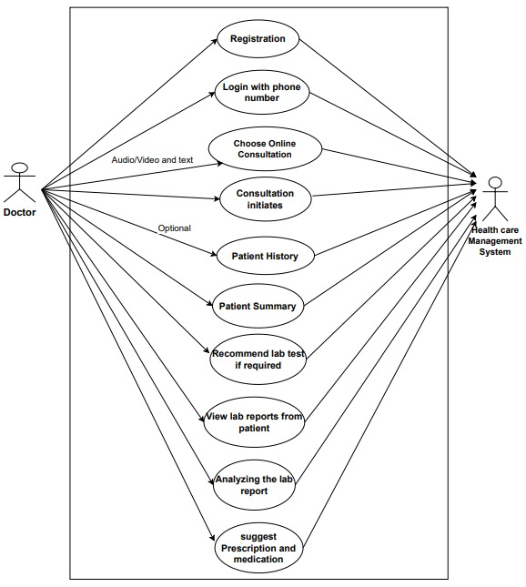
Use Case Diagram For Doctor:

Slide 16
Description:

Slide 17
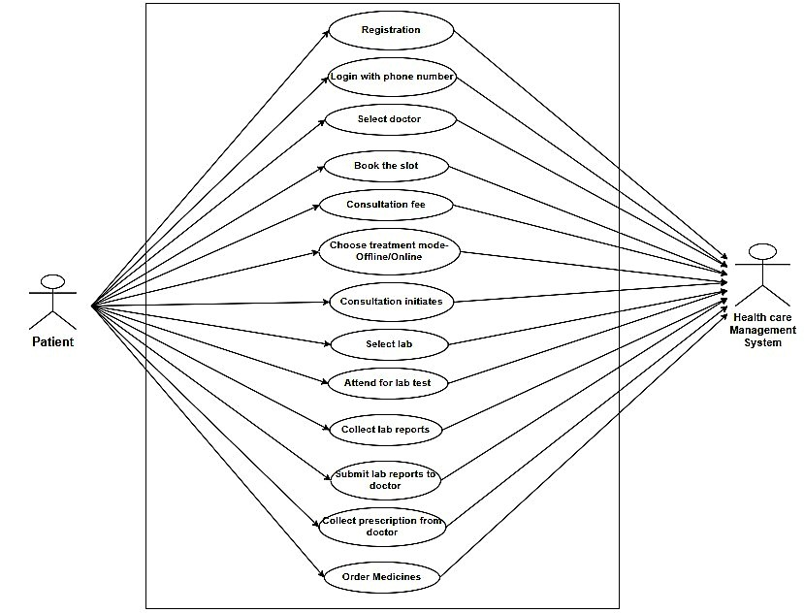
Use Case Diagram For Patient:

Slide 18
Description:

Slide 19
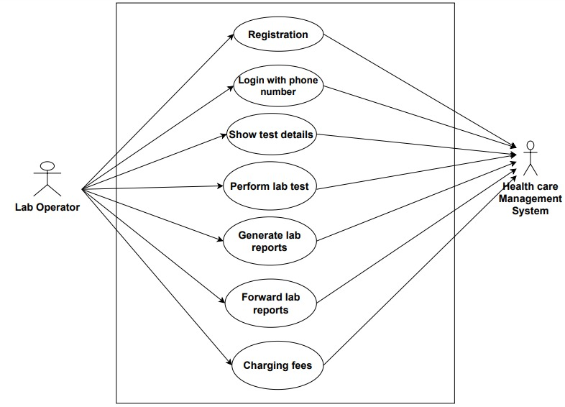
Use Case Diagram For Lab Operator:

Slide 20
Description:

Slide 21
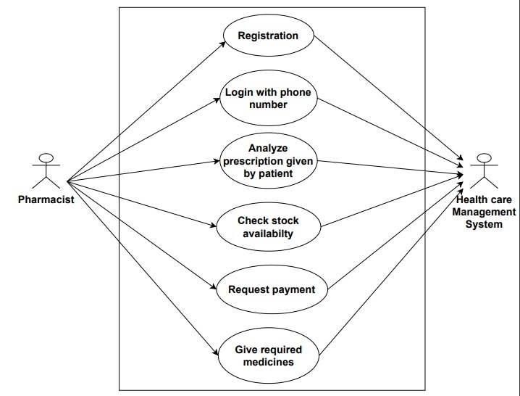
Use Case Diagram For Pharmacist:

Slide 22
Description:

